Slide 1

Task (Dataset provided) What kind of experiences/triggers leads to an increased likelihood of a session ending?
MG Asia Technical Assignment

Slide 2
High-level Data-Driven Approach
Experiences/triggers
Session ending
Proxied using raw/derived features from available dataset
Important features
Significant features
Predictive features

Slide 3
High-level Data-Driven Approach
Significant features
Important features
Explanatory modeling
Exploratory data analysis and feature engineering
Predictive features
Predictive modeling

Slide 4
1.
DATA LOADING/CLEANING/ UNDERSTANDING

Slide 5
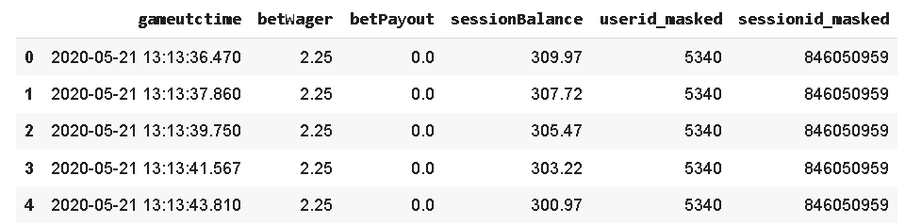
Dataset Overview
DIMENSIONS
Number of rows: 2487382
Number of columns: 6
DATATYPES
gameutctime: object
betWager: float64
betPayout: float64
sessionBalance: float64
userid_masked: int64
sessionid_masked: int64

Slide 6
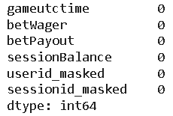
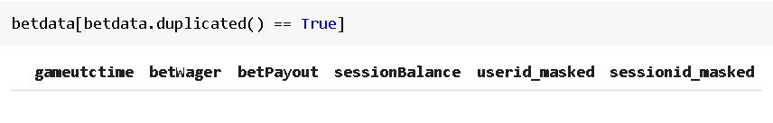
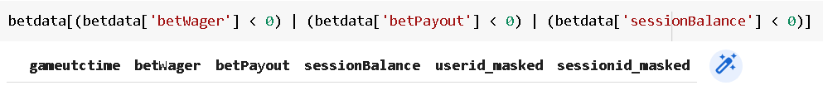
Check for Missing Values/Duplicate Rows/Data Anomalies
Missing values Duplicate rows
gameutctime + sessionid_masked should keep all rows unique
Data anomalies
1) No negative bet wager
2) No negative bet payout
3) No negative session balance

Slide 7
Check Number of Unique Values in Each Column
Column | Number of unique values | Comments (if any)
gameutctime | 2441545 | Can be repeated if different players start a bet simultaneously
betWager | 10 | Exists in 10 different amounts (based on this dataset)
betPayout | 742 | Depends on the bet wager and the payout odds (mostly 0 as most bets do not pay out)
sessionBalance | 309705 | N/A
userid_masked | 4036 | 4036 unique users
sessionid_masked | 8435 | 8435 sessions (average 2 sessions/user)

Slide 8
Descriptive Statistics of Continuous Features
 | betWager | betPayout | sessionBalance
mean | 13.74 | 13.26 | 1182.10
std | 39.26 | 141.71 | 8117.79
min | 2.25 | 0.00 | 0.00
25% | 2.25 | 0.00 | 115.08
50% | 4.50 | 0.00 | 294.83
75% | 9.00 | 2.50 | 741.35
max | 900.00 | 50500.00 | 382191.50
Mean bet payout < Mean bet wager
A player can expect to receive back (13.26/13.74)*100 = $96.50 for every $100 wagered.
House edge ~ 3.5% based on this dataset
Session Balance
Most players' balances hover below $1000 with some extreme cases

Slide 9
2.
EXPLORATORY DATA ANALYSIS AND FEATURE ENGINEERING
Visualizations/Hypothesis testing/Creation of binary label/Creation of informative features

Slide 10
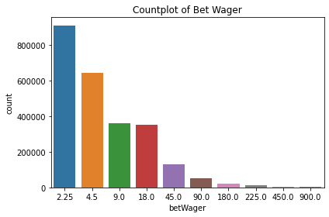
Countplot of Bet Wager
Bet wagers exist in fixed denominations
Most bet wagers are small (2.25, 4.5, 9.0, 18.0)
Subsequent wager values tend to double in size
2.25 * 2 = 4.5
4.5 * 2 = 9.0
Players might double their wager after a loss or halve their wager after a win

Slide 11
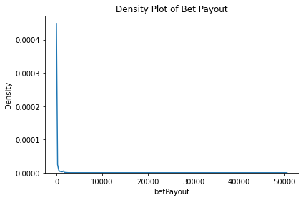
Density Plot of Bet Payout
Right-skewed distribution where most payouts are 0
Correspond to the bet wager distribution where most wagers are in small amounts which lead to smaller sized payouts as well
Largest payouts can go above $50000

Slide 12
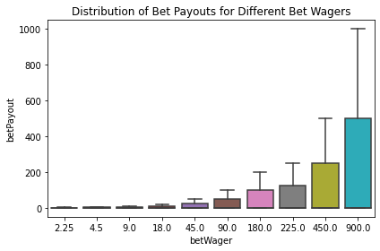
Distribution of Bet Payouts for Different Bet Wagers
- For each bet wager amount, approximately 50% of the bets will receive payouts that are roughly half the value of the wager and below.

Slide 13
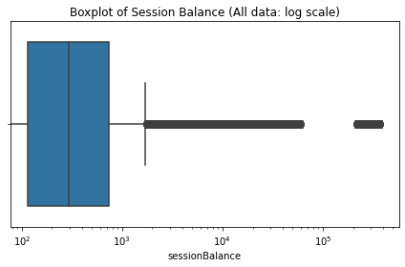
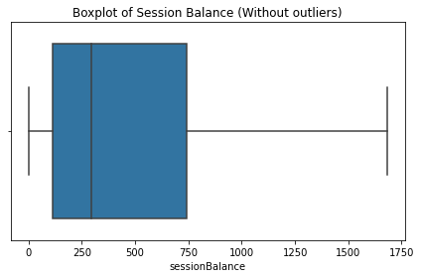
Boxplots of Session Balance (With and Without Outliers)
Most session balances lie within the $100-1800 range
Some players have session balances of up to a few hundred thousand dollars

Slide 14
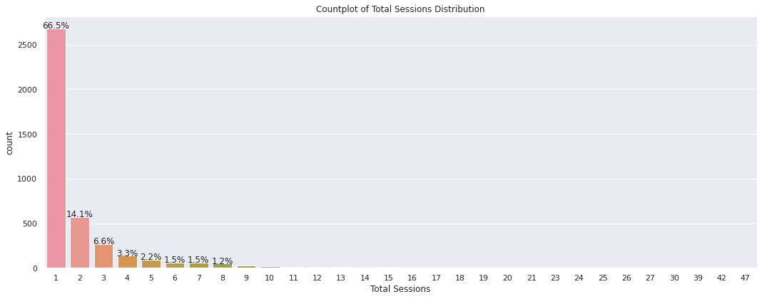
Countplot of Total Sessions Distribution
Most players (>90%) played around 1-5 sessions in the 3 days with 1 session being the most common
Only minority of players played more than 5 sessions

Slide 15
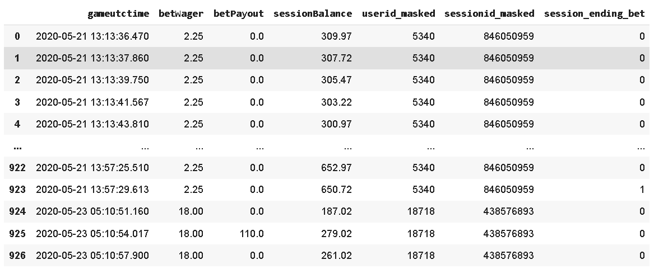
Creation of Binary Class Label ‘session_ending_bet’
Indicates whether a particular bet is the session's last bet
Label mapping:
0 = No
1 = Yes
To be used for further analysis with raw/derived features, explanatory and predictive modeling purposes
Imbalanced class distribution with 99.66% of rows belonging to the negative class (0)
Last bet for the session

Slide 16
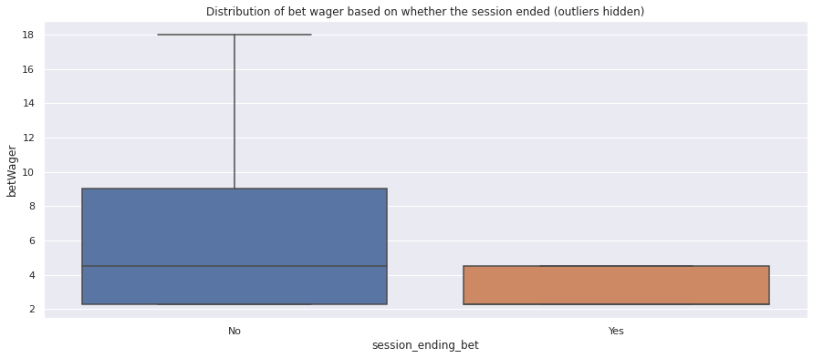
Distribution of Bet Wager Based on Whether the Session Ended
Can observe that if the session ended, the final bet wager is lower.
However, this doesn't work in reverse as low bet wagers are much more common.
i.e. cannot reliably predict a session ending based solely on low bet wager

Slide 17
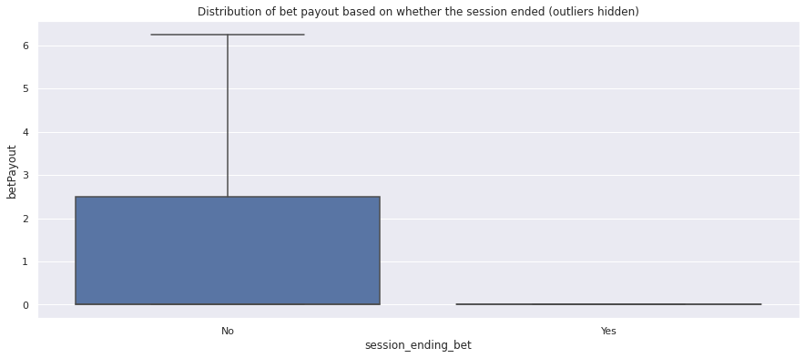
Distribution of Bet Payout Based on Whether the Session Ended
Can observe that if the session ended, the final bet payout is usually 0.
However, this doesn't work in reverse as bet payout of 0 is very common.
i.e. cannot reliably predict a session's last bet based solely on bet payout of 0

Slide 18
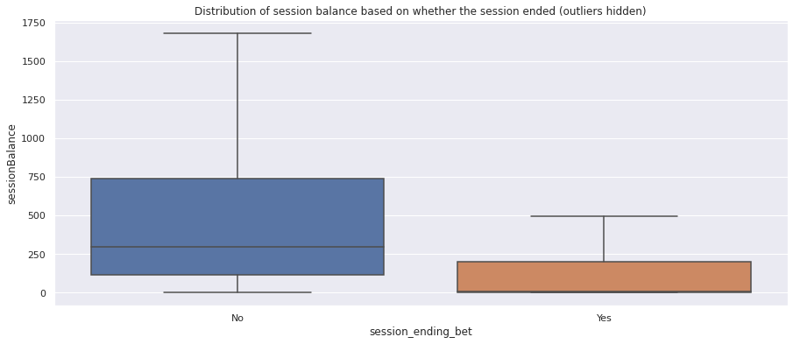
Distribution of Session Balance Based on Whether the Session Ended
Can observe that if the session ended, the final session balance tends to be low.
However, this doesn't work in reverse as most players have low balances throughout.
i.e. cannot reliably predict a session's last bet based solely on low session balances

Slide 19
Feature Engineering Approach
Challenges
Current features, specifically the continuous types have right-skewed distributions with extreme outliers
Challenging to interpret explanatory models (e.g. p-values and coefficients)
Challenging to build predictive models (e.g. higher noise and variance)
Removing outliers/extreme values can be difficult and subjective
Excluding bets with high wagers/payouts/session balances might result in inaccurate modelling or understanding of VIP players who might be hugely profitable for the gaming operator (80/20 rule)

Slide 20
Feature Engineering Approach
Solution
Middle ground approach
Create binary features to include the extreme figures in one of the bins
Create numeric features that will result in less skewed distributions
Create 5 new features
lost_money
lowered_wager
sess_len_min
withdrew_funds
loss_streak_counter

Slide 21
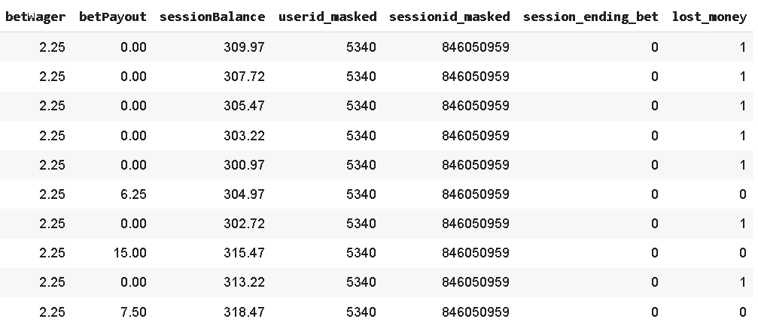
Engineered Feature: ‘lost_money’
Indicates whether the player lost money on a particular bet
1 = Yes
0 = No
If betPayout < betWager, the player has effectively lost money on that bet

Slide 22
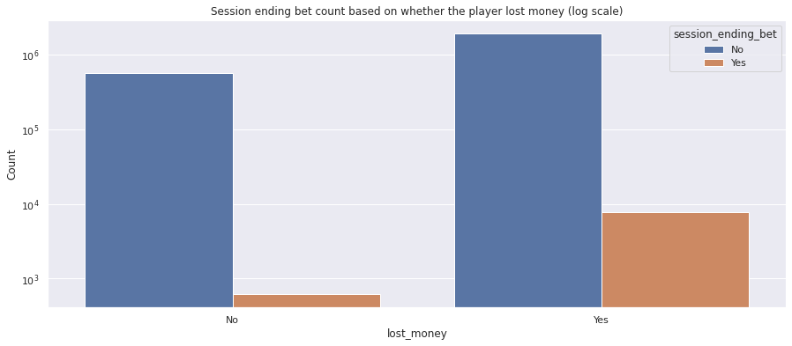
Engineered Feature: ‘lost_money’
Chi-Square Test for Independence Between Categorical Variables
Null hypothesis: There is no significant relationship between 'lost_money' and 'session_ending_bet’.
Alternative hypothesis: There is a significant relationship between 'lost_money' and 'session_ending_bet'.
Significance level (α): 0.05
Since the p-value (1.02e-254) is smaller than our chosen significance level (α = 0.05), there is sufficient evidence to reject the null hypothesis and conclude that there is a significant relationship between 'lost_money' and 'session_ending_bet’.
X² statistic: 1169.66
Limitation: A chi-square value cannot tell you what the relationship is between two variables, only that a relationship exists between the two variables

Slide 23
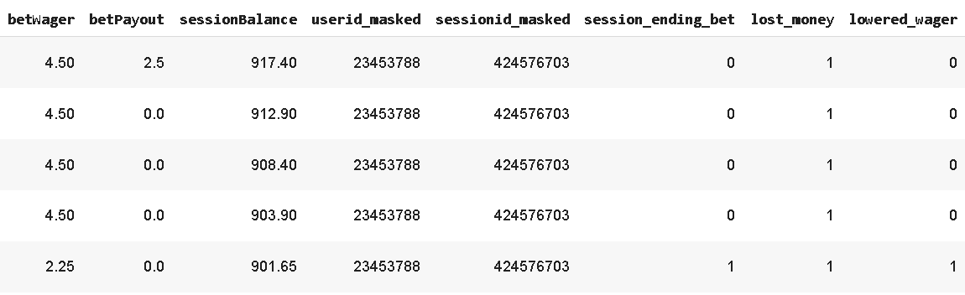
Engineered Feature: ‘lowered_wager’
Indicates whether the player lowered the wager relative to the last bet
1 = Yes
0 = No
If betWager[i] < betWager[i-1], the player has lowered the wager

Slide 24
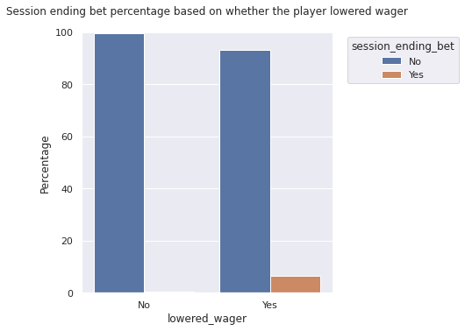
Engineered Feature: ‘lowered_wager’
Chi-Square Test for Independence Between Categorical Variables
Null hypothesis: There is no significant relationship between 'lowered_wager' and 'session_ending_bet’.
Alternative hypothesis: There is a significant relationship between 'lowered_wager' and 'session_ending_bet'.
Significance level (α): 0.05
Since the p-value (1.02e-254) is smaller than our chosen significance level (α = 0.05), there is sufficient evidence to reject the null hypothesis and conclude that there is a significant relationship between 'lowered_wager' and 'session_ending_bet’.
X² statistic: 12720.26

Slide 25
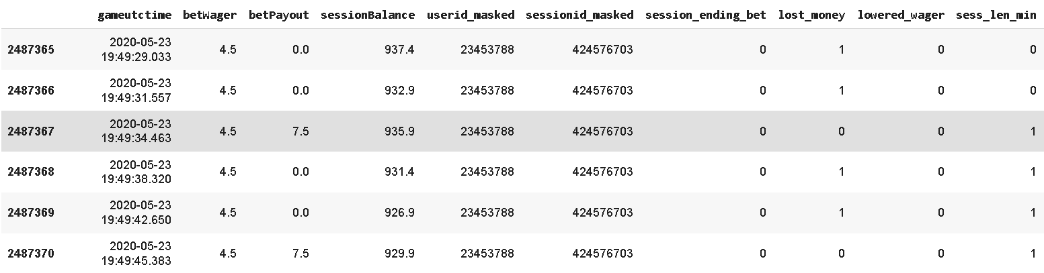
Engineered Feature: ‘sess_len_min’
Indicates how many minutes have passed since the start of the session
Proxy of physical/mental fatigue after gaming for a certain period of time

Slide 26
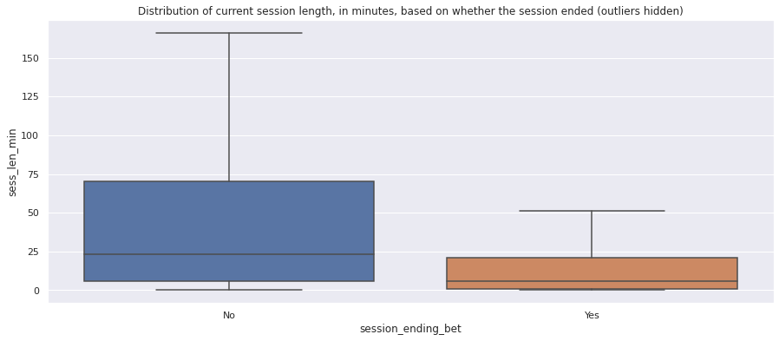
Engineered Feature: ‘sess_len_min’
Welch’s t-test (Assess if the means of two populations are equal)
Null hypothesis: The session length mean of session-ending bet is equal to the session length mean of non session-ending bet.
Alternative hypothesis: The session length mean of session-ending bet is not equal to the session length mean of non session-ending bet.
Significance level (α): 0.05
t-score: -84.5045763414884
Since the p-value (0.0) is smaller than our chosen significance level (α = 0.05), there is sufficient evidence to reject the null hypothesis and conclude that the session length mean of session-ending bet is not equal to the session length mean of non session-ending bet.
Most sessions tend to end quite fast (less than 25 minutes)
Sessions that go beyond 25 minutes tend to go on for much longer amount of time (wider body from median to upper quartile as compared to the lower quartile)

Slide 27
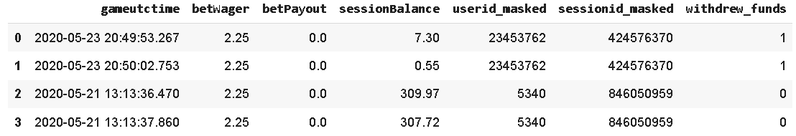
Engineered Feature: ‘withdrew_funds’
Indicates whether the player withdrew funds from the account
Might be a sign that the player is about to stop playing
Low session balance
Achieved target amount for the session

Slide 28
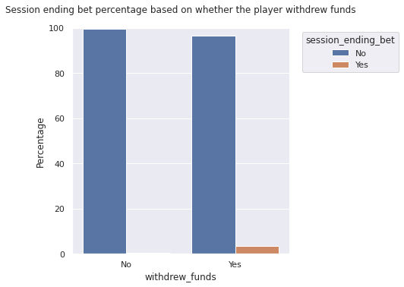
Engineered Feature: ‘withdrew_funds’
Chi-Square Test for Independence Between Categorical Variables
Null hypothesis: There is no significant relationship between 'withdrew_funds' and 'session_ending_bet’.
Alternative hypothesis: There is a significant relationship between 'withdrew_funds ' and 'session_ending_bet'.
Significance level (α): 0.05
Since the p-value (0.0) is smaller than our chosen significance level (α = 0.05), there is sufficient evidence to reject the null hypothesis and conclude that there is a significant relationship between 'withdrew_funds' and 'session_ending_bet’.
X² statistic: 13917.34

Slide 29
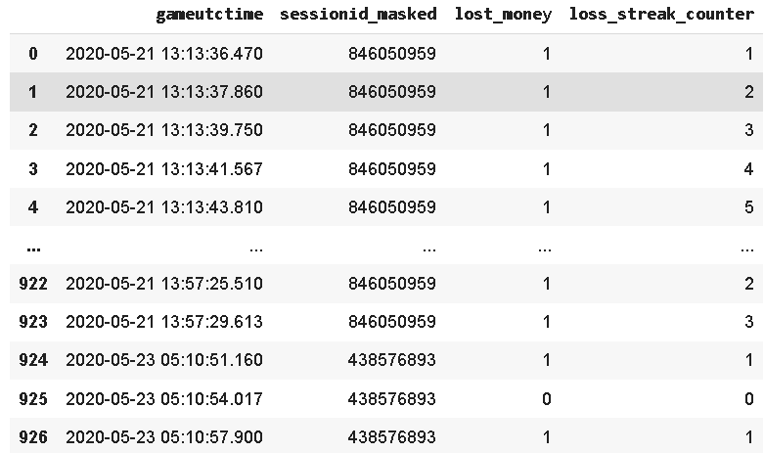
Engineered Feature: ‘loss_streak_counter’
Indicates the current loss streak of the player within a session
Might affect the morale of the player and tendency to end the session
Luck has run out and should come back another time
Long loss streak can reduce session balance to an amount low enough to justify leaving or forced to leave

Slide 30
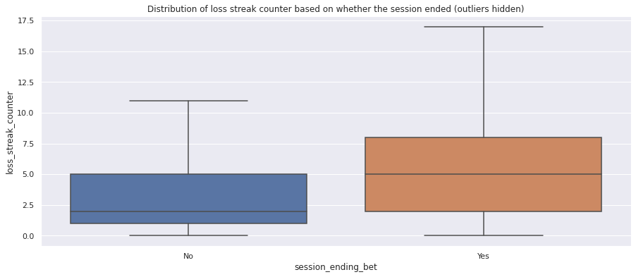
Engineered Feature: ‘loss_streak_counter’
Welch’s t-test (Assess if the means of two populations are equal)
Null hypothesis: The mean loss streak of session-ending bet is equal to the mean loss streak of non session-ending bet.
Alternative hypothesis: The mean loss streak of session-ending bet is not equal to the mean loss streak of non session-ending bet.
Significance level (α): 0.05
t-score: 45.39200744605106
Since the p-value (0.0) is smaller than our chosen significance level (α = 0.05), there is sufficient evidence to reject the null hypothesis and conclude that the mean loss streak of session-ending bet is not equal to the mean loss streak of non session-ending bet.
Visibly higher loss streaks encountered when the bet is the last for the session as compared to when it's not
Session ending bets have median loss streaks of around 5 with half of them ranging between 2-8

Slide 31
3.
EXPLANATORY MODELING
Why is this the last bet?

Slide 32
Explanatory Modeling (Logistic Regression)
Interested in identifying variables that have a statistically significant relationship with the outcome (session ending or not)
Key steps
Fitting potentially theoretically important predictors
Checking for statistical significance
Evaluating effect sizes
Running diagnostics
Train-test split is not performed

Slide 33
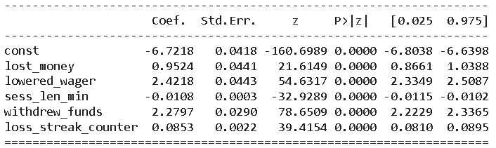
Raw Model Summary
Coefficient is interpreted as the expected change of the log odds as X changes, while controlling for the effects of other X variables
- For categorical variables, the log odds is calculated with respect to the reference category
Here, the reference category is the label "0". Since our categorical variables are all binary, the coefficient is essentially the expected increase/decrease in the log odds of the session ending as we switch X from label "0" to label "1".
- For continuous variables, the interpretation is as follows
For every 1 unit increase in X, the coefficient is the expected change (increase/decrease) of the log odds of the session ending.

Slide 34
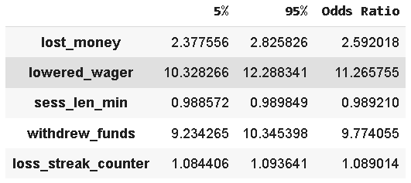
Odds Ratio Confidence Interval
lost_money: The odds of a session ending when a player loses money is 2.59 times greater than when a player does not lose money.
lowered_wager: The odds of a session ending when a player lowers wager is 11.27 times greater than when a player does not lower wager.
sess_len_min: For every 1 minute increase in the session length, we can expect a 1.1% decrease in the odds of a session ending.
withdrew_funds: The odds of a session ending when a player withdraws fund is 9.77 times greater than when a player does not withdraw fund.
loss_streak_counter: For every 1 additional count of loss streak, we can expect a 8.9% increase in the odds of a session ending.

Slide 35
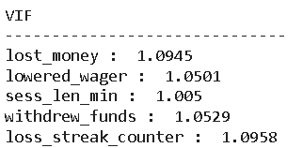
Check for the absence of multicollinearity
Calculate variance inflation factor (VIF)
The smallest possible value for VIF is 1, which indicates the complete absence of collinearity
VIFs between 1 and 5 suggest that no corrective measures are required
All the VIFs are less than 5 which are within the acceptable range

Slide 36
4.
PREDICTIVE MODELING
Will this be the last bet?

Slide 37
Predictive Modeling
Interested in finding the strongest associations between predictor variables and the outcome variable to generate good predictions (session ending or not)
Less concerned about explaining why a variable is important in predicting the outcome
A significant predictor based on hypothesis testing or explanatory modeling that adds no predictive benefit to the model is usually excluded
Train-test split is required to test how the trained predictive model performs on data it has never seen before

Slide 38
Feature Selection Based on Decision Tree Variable Importance
Key steps
Perform 70/30 train-test split
Fit the decision tree model and optimize the hyperparameters using random search
Predict on the test set
Obtain the feature importance rankings of the predictor variables

Slide 39
Confusion Matrix Trade-offs
 | Definition | Possible Business Impact
True Positives | Correctly predicted a session ending | Provide free spins to the players and potentially retain them long enough to offset the cost of the free spins where: No. of extra bets * House edge * Avg wager amount > No. of free spins * (1 – House edge) * Avg wager amount
False Positives | Incorrectly predicted a session ending | Provide free spins too early with low marginal utility
True Negatives | Correctly predicted a session as not ending | Avoid providing free spins too early
False Negatives | Incorrectly predicted a session as not ending | Miss out on the opportunity to retain the players and capitalize on the house edge for extra profits

Slide 40
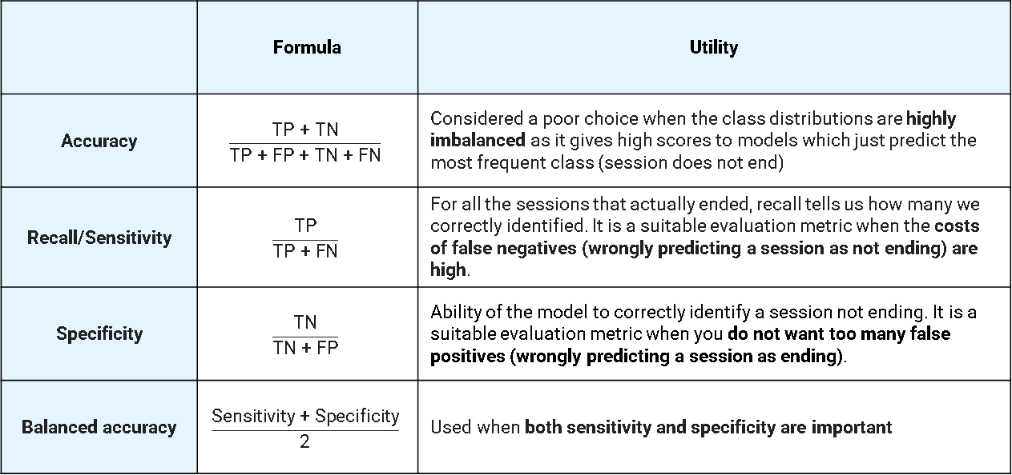
Choice of Evaluation Metrics
 | Formula | Utility
Accuracy | $$\frac{\text{TP}\text{ + }\text{TN}}{\text{TP}\text{ + }\text{FP}\text{ + }\text{TN}\text{ + }\text{FN}}$$ | Considered a poor choice when the class distributions are highly imbalanced as it gives high scores to models which just predict the most frequent class (session does not end)
Recall/Sensitivity | $$\frac{\text{TP}}{\text{TP}\text{ + }\text{FN}}$$ | For all the sessions that actually ended, recall tells us how many we correctly identified. It is a suitable evaluation metric when the costs of false negatives (wrongly predicting a session as not ending) are high.
Specificity | $$\frac{\text{T}\text{N}}{\text{T}\text{N}\text{ + }\text{FP}}$$ | Ability of the model to correctly identify a session not ending. It is a suitable evaluation metric when you do not want too many false positives (wrongly predicting a session as ending).
Balanced accuracy | $$\frac{\text{Sensitivity}\text{ + }\text{Specificity}}{\text{2}}$$ | Used when both sensitivity and specificity are important

Slide 41
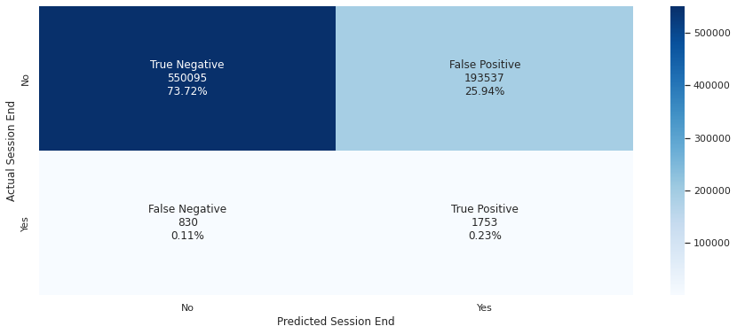
Confusion Matrix and Performance Metrics
Performance Metrics
Recall (Sensitivity): 67.8668 %
Specificity: 73.9741 %
Balanced accuracy: 70.9205 %
Testing Set Distribution of ‘session_ending_bet’
0: 743632
1: 2583

Slide 42
Baseline Balanced Accuracy
A baseline balanced accuracy acts as a lower bound to evaluate the performances of the machine learning model.
The baseline model will be defined as the dummy predictor where it will predict the majority class (session will not end or 0) all the time.
A trained model is usually expected to perform better than the baseline model. Otherwise, there is no reason to use the model.

Slide 43

Baseline Balanced Accuracy
Given that the baseline model predicts 0 all the time, the specificity will be 1 (able to detect all negatives). There will be no false positives since the model only predicts 0.
On the other hand, the recall/sensitivity will be 0. Since the baseline model predicts a session not ending (0) all the time, it will never predict a session ending (1). Therefore, true positives equal 0.
Baseline balanced accuracy = $\frac{\text{Sensitivity}\text{ + }\text{Specificity}}{\text{2}}$
= $\frac{\text{0}\text{ + }\text{1}}{\text{2}}$
= 0.5 or 50%

Slide 44
Baseline Balanced Accuracy
Baseline Model (Predicts 0 all the time)
Baseline balanced accuracy = 50%
Decision Tree
Balanced accuracy = 70.9205%
Decision tree has better balanced accuracy than the baseline model.

Slide 45
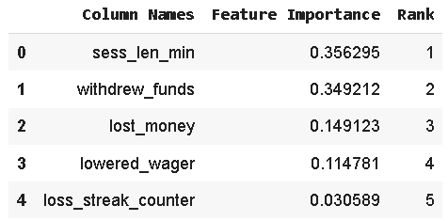
Obtain the Feature Importance Based on the Best Decision Tree
Feature importance is calculated as the decrease in node impurity weighted by the probability of reaching that node.
Each node probability can be calculated by the number of samples that reach it, divided by the total number of samples. The higher the value the more important the feature.

Slide 46
Feature Selection Based on Recursive Feature Elimination of Logistic Regression
Key steps
Recursive feature elimination searches for a subset of features by starting with all features in the training dataset and successfully removing features until the desired number is achieved.
This is achieved by fitting the given machine learning algorithm (logistic regression in this case), ranking features by importance, discarding the least important features, and re-fitting the model. This process is repeated until a specified number of features remains.
Model needs to have some coefficient or feature importance calculation internally

Slide 47
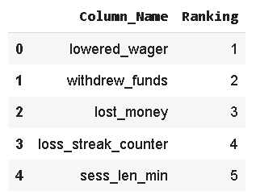
Feature Selection Based on Recursive Feature Elimination of Logistic Regression
Performance Metrics
Recall (Sensitivity): 8.5599 %
Specificity: 99.5995 %
Balanced accuracy: 54.0777 %
Testing Set Distribution of ‘session_ending_bet’
0: 743632
1: 2583

Slide 48
5.
CONCLUSION

Slide 49
Comparison of Feature Rankings Across Different Methods
 | lost_money | lowered_wager | sess_len_min | withdrew_funds | loss_streak_counter
Odds Ratio Confidence Interval (Logistic regression) | 3 | 1 | 5 | 2 | 4
Variable Importance (Decision Tree) | 3 | 4 | 1 | 2 | 5
Recursive Feature Elimination (Logistic Regression) | 3 | 1 | 5 | 2 | 4

Slide 50
Thank You

